Slide 1

Git Fun(damentals)
Have fun with Git without going mental!

Slide 2

History
In 2005, Linus Torvalds, the creator of Linux, needed to replace the version control system used to manage the source code of the Linux kernel. He, and the Linux community, created Git. Some of the goals of the new system included:
Speed
Simple design
Strong support for non-linear development (thousands of parallel branches)
Fully distributed
Able to handle large projects like the Linux kernel efficiently (speed and data size)

Slide 3

What is Git?
A distributed version control system
Tracks the history of changes from multiple contributors
Any earlier version of the project can be recovered at any time
Each contributor has a full copy of the project and history
DVCSs don’t need a constant connection with a central repository

Slide 4
Stream of snapshots
The way Git thinks about its data is different from other VCS. Conceptually, most other systems store information as a list of file-based changes. They store the data as a set of files and the changes made to each file over time.
Git thinks of its data more like a series of snapshots of a miniature filesystem. Every time you commit, Git takes a picture of what all your files look like at that moment and stores a reference to that snapshot.
To be efficient, if files have not changed, Git doesn’t store the file again, just a link to the previous identical file it has already stored. Git thinks about its data more like a stream of snapshots.
We’ll explore some of the benefits you gain by thinking of your data this way when we cover Git branching in Git Branching.

Slide 5
Git is distributed
Nearly Every Operation Is Local
In CVCS, you must connect to the central store to access and update the history. With Git you have the entire history of the project right there on your local disk, most operations seem almost instantaneous.
This also means that there is very little you can’t do if you’re offline. If you get on an airplane or a train and want to do a little work, you can commit happily (to your local copy, remember?) until you get to a network connection to upload. If you go home and can’t get your VPN client working properly, you can still work.

Slide 6
Git is safe
Integrity
Git uses SHA-1 hashes of data to verify integrity
The SHA-1 hash is used to identify every object in the database
Git only adds data
Nearly every operation adds information to the database
It is nearly impossible to delete anything
This allows you to easily a recover previous state

Slide 7
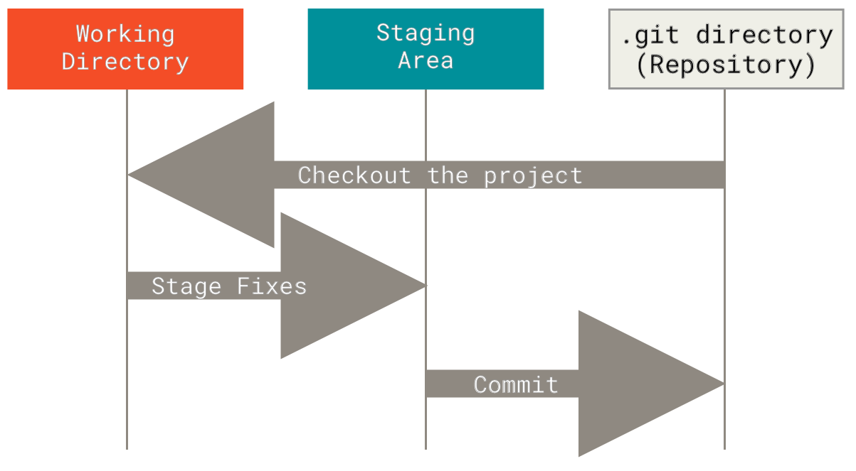
Git’s Three States
Working directory – repo directory on the local file system
.git directory – hidden directory in root of the repo
Staging Area – index file in .git directory
Notes:
The working tree is a single checkout of one version of the project. These files are pulled out of the compressed database in the Git directory and placed on disk for you to use or modify.
The staging area is a file, generally contained in your Git directory, that stores information about what will go into your next commit. Its technical name in Git parlance is the “index”, but the phrase “staging area” works just as well.
The Git directory is where Git stores the metadata and object database for your project. This is the most important part of Git, and it is what is copied when you clone a repository from another computer.
The basic Git workflow goes something like this:
You modify files in your working tree.
You selectively stage just those changes you want to be part of your next commit, which adds only those changes to the staging area.
You do a commit, which takes the files as they are in the staging area and stores that snapshot permanently to your Git directory.
If a particular version of a file is in the Git directory, it’s considered committed. If it has been modified and was added to the staging area, it is staged. And if it was changed since it was checked out but has not been staged, it is modified. In Git Basics, you’ll learn more about these states and how you can either take advantage of them or skip the staged part entirely.
.git stores
- references (HEAD, branches, tags, etc.)
- configuration and metadata
- index: This file is also known as the staging area. It keeps track of the changes that are staged for the next commit.
- objects/: This directory stores all the content of your repository, including commits, trees, and blobs. These objects are stored in a compressed format and are identified by their SHA-1 hash.

Slide 8
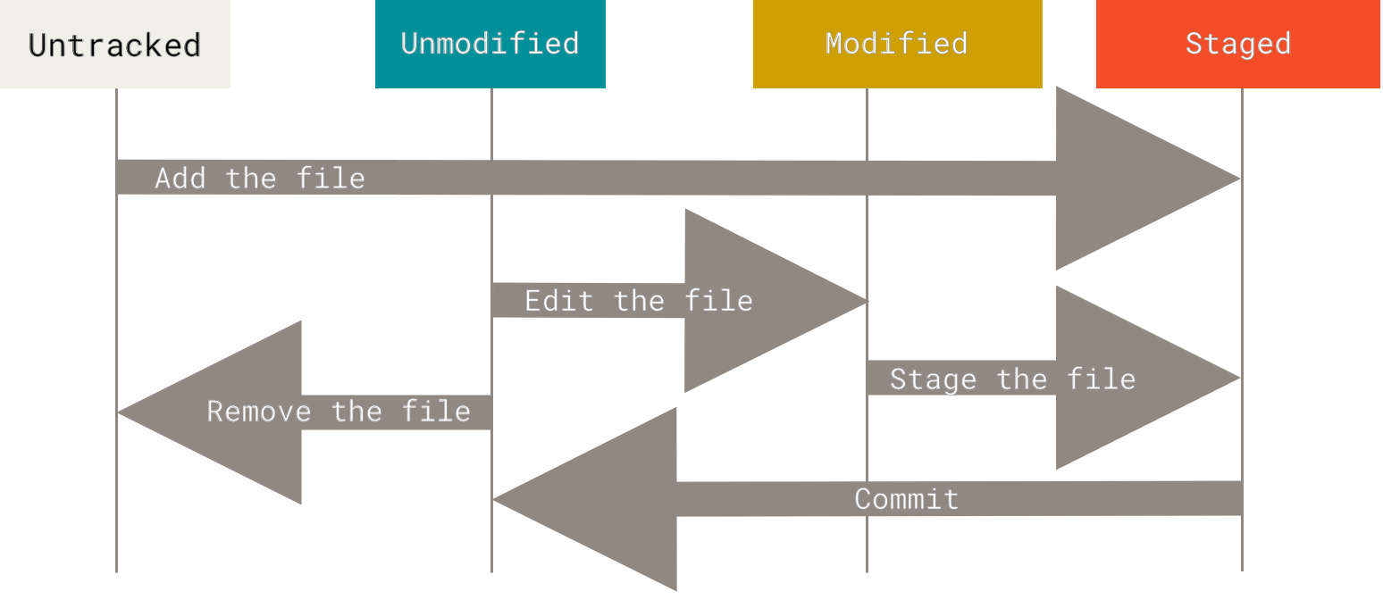
Tracking changes
Tracked
Notes:
git status

Slide 9
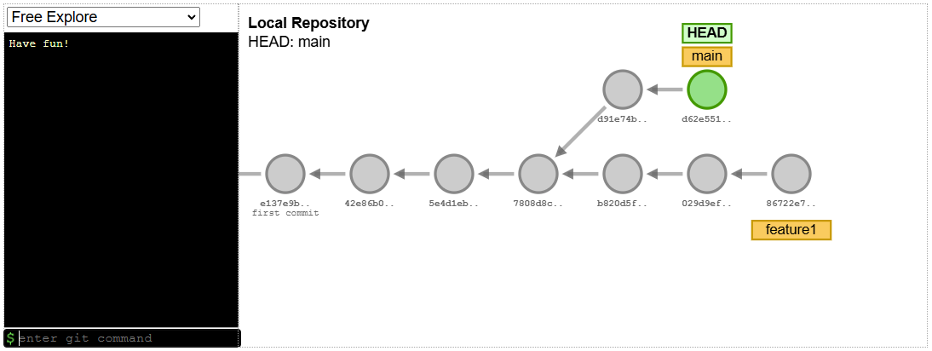
What is a branch?
Image from https://git-school.github.io/visualizing-git/

Slide 10
What is a branch?
Branching means you diverge from the main line of development and continue to do work without messing with that main line. In many VCS tools, this is a somewhat expensive process, often requiring you to create a new copy of your source code directory, which can take a long time for large projects.
When you make a commit, Git stores a commit object that contains a pointer to the snapshot of the content you staged. This object also contains the author’s name and email address, the message that you typed, and pointers to the commit or commits that directly came before this commit (its parent or parents): zero parents for the initial commit, one parent for a normal commit, and multiple parents for a commit that results from a merge of two or more branches.

